Slide 1
Climate Change Modeling
Submitted by: Chandan Bhattacharya

Slide 2
Project Overview
Overview:
This project aims to analyze public sentiment on climate change by leveraging NASA’s climate data and applying advanced natural language processing (NLP) techniques.
Importance:
Understanding public perception helps in crafting effective communication strategies and informs policy decisions.

Slide 3
Objectives
Content:
Analyze sentiment related to climate change using NLP techniques.
Correlate public sentiment with real-world climate data from NASA.
Model and visualize sentiment trends over time.

Slide 4
Technologies and Tools
Python: Main programming language for analysis.
NLTK & Punkt: For text preprocessing and tokenization.
RoBERTa: Transformer model for deep sentiment analysis.
VADER: Lexicon-based sentiment analysis for cross-verification.
Naive Bayes: A simple probabilistic classifier based on Bayes' Theorem.
Random Forest: An ensemble learning method that constructs multiple decision trees and outputs the mode of the classes.

Slide 5
Methodology
Text Preprocessing: Used NLTK and Punkt for tokenization and cleaning of textual data.
Sentiment Analysis: Applied RoBERTa for deep learning-based sentiment analysis and cross-verified results with VADER.
Modeling & Visualization: Analyzed sentiment trends and correlated them with climate data, followed by visualization of results.
Naive Bayes Classifier
Random Forest Classifier

Slide 6
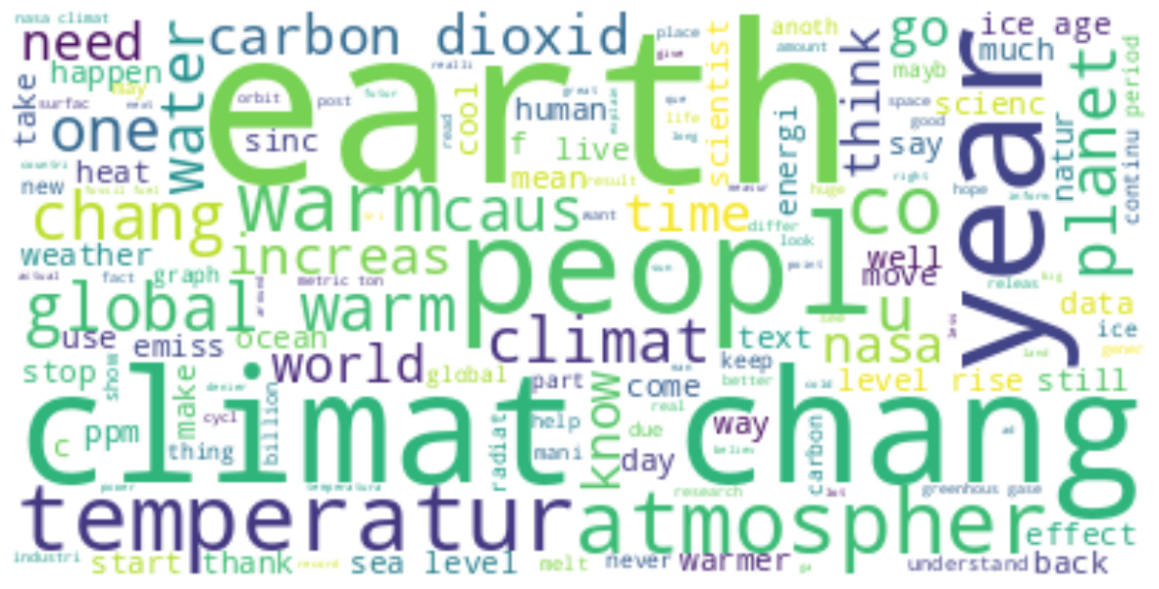
Use a Word Cloud to Visualize the Most used Words in the Comments

Slide 7
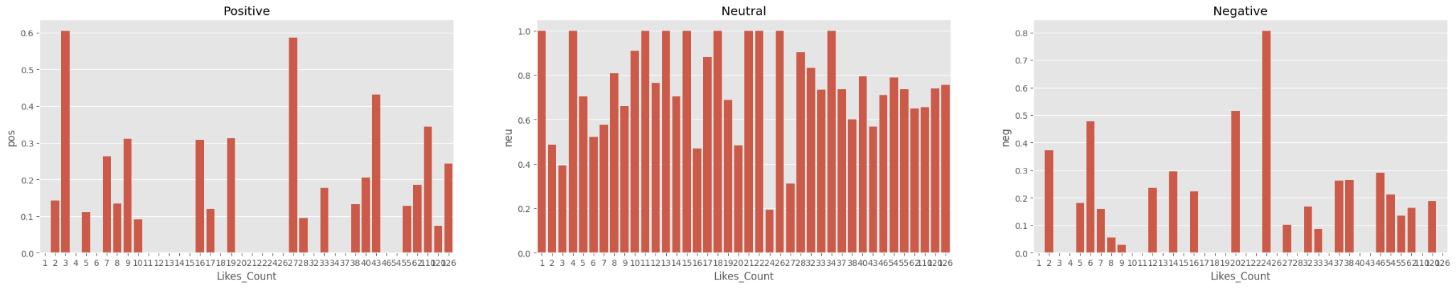
Positive, Negative and Neutral sentiments of Reviewers by Using Vader

Slide 8
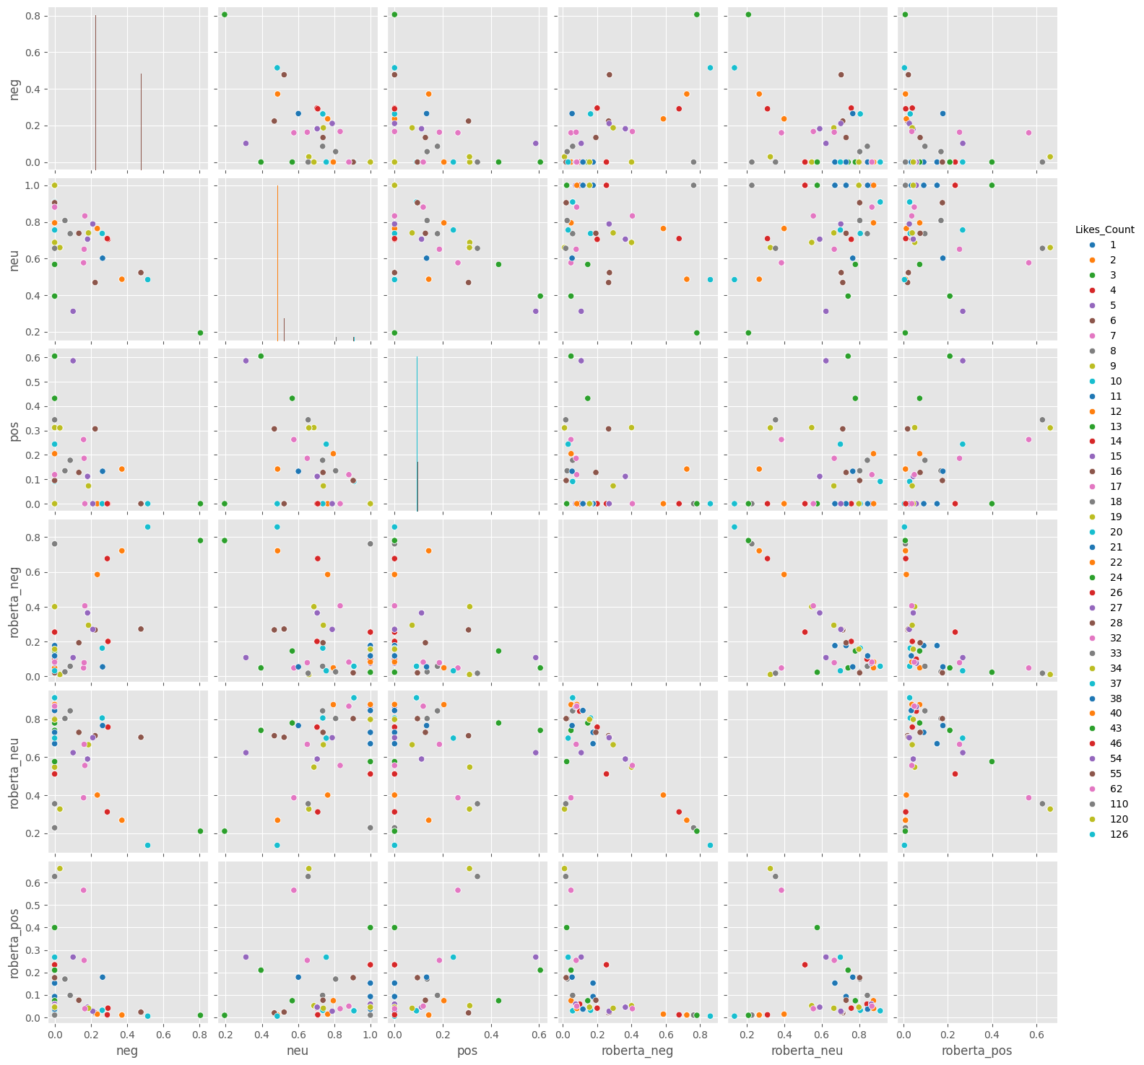
Compare Scores Between Vader and Roberta Models

Slide 9
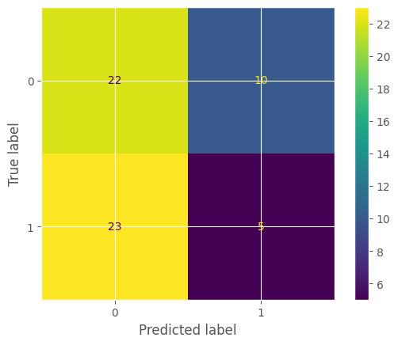
Multinomial Naive Bayes Analysis
Accuracy Result: 45%

Slide 10
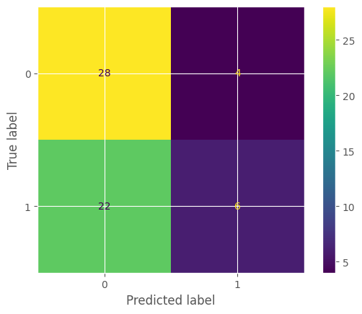
RandomForestClassifier Analysis
Accuracy Result: 56%

Slide 11
Result and Insights
Accuracy Results:
Naive Bayes: "Accuracy: 45%"
Random Forest: "Accuracy: 56%"
Key Findings:
Observed trends in sentiment over time.
Notable patterns in public and scientific discussions on climate change.

Slide 12
Conclusion
Summary:
The sentiment analysis provides a deeper understanding of climate change discussions.
Impact:
Insights could inform policy decisions and public awareness efforts.

Slide 13
Thank You

